Slide 1
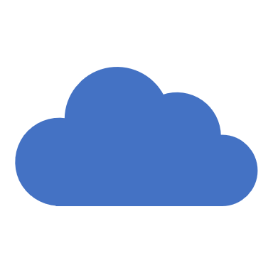
Arduino Cloud
A brief Intro

Slide 2
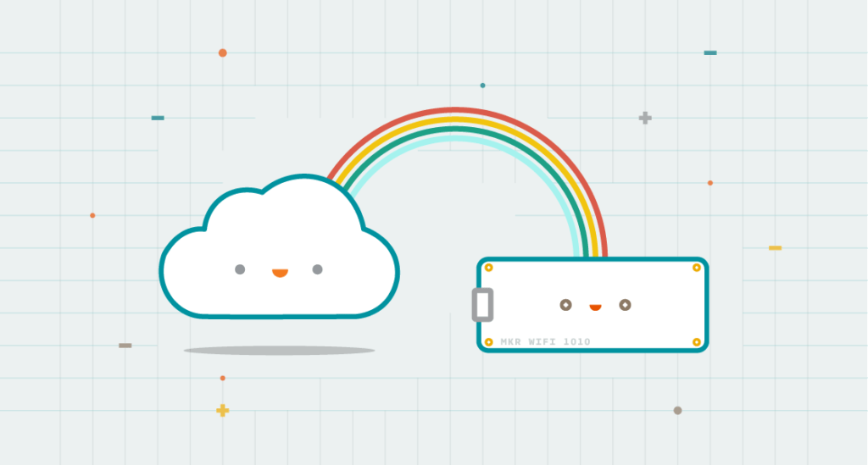
What’s Arduino Cloud
Arduino Cloud is a platform which allows users to remotely manage, monitor and control IoT devices.
connect, monitor and control devices through the internet, anywhere, any time.
Rapid set up IoT devices and applications, and manage data from multiple devices.
This Photo by Unknown Author is licensed under CC BY-SA-NC

Slide 3
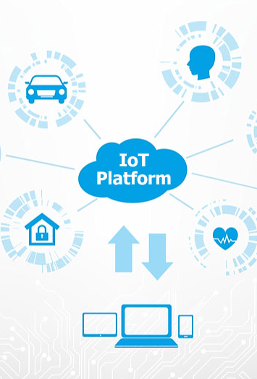
What’s an IoT Platform?
IoT (Internet of Things) platform is a software/hardware infrastructure that enables the development, deployment, and management of IoT solutions and applications.
Similar to google drive(develop/deploy/manage documents and files)
Often cloud based(as in you don’t host it on your own computers)
Typical components of an IoT platform are:
managing and controlling connected devices (your Arduino)
Data Collection and Processing(e.g. collect data from environment)
Visualisation and analysis

Slide 4
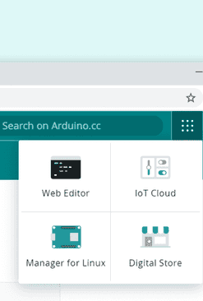
Using the Arduino Cloud
Use browser-based IDE
You’ll need to create an Arduino account
You can use Google, Guthub, Facebook, Apple ID if you wish
Once signed in, you can access the IoT Cloud through the Menu

Slide 5
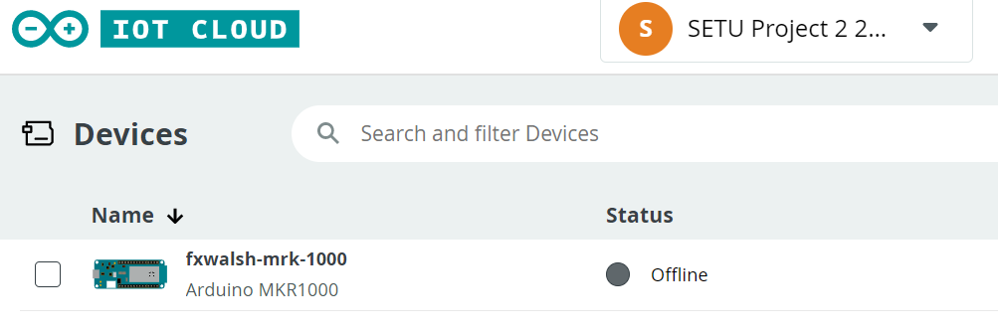
Devices in Arduino Cloud
Configuration is required once for every new device.
In our case the Arduino MKR 1000
In Arduino IoT Cloud, add a device though the Devices menu option
Once a device is successfully configured it can be used to create a “thing”.

Slide 6
Things in Arduino Cloud
A “Thing” is a combination of a Device and configuration details such as wifi config, variables, and other settings.
Needs to be associated with a device to work
Why are Devices and Things distinct concepts?
You can easily swap the actual hardware without reconfiguring everything from scratch: just detach a thing from a device, and ressign it to another device.(for example, you want to use another/different Arduino board

Slide 7
Variables in Arduino Cloud
A thing can have one or more variables.
A variable can be used for:
collecting data over time in the cloud (sensor readings)
show data in real-time in a dashboard
receive changes originated from a dashboard or other linked devices
Arduino IoT Cloud will handle all the communication and synchronization behind the scenes.
Variables can be used directly just like any other variables in an Arduino sketch.
Can be used to share data with other devices/dashboards.

Slide 8
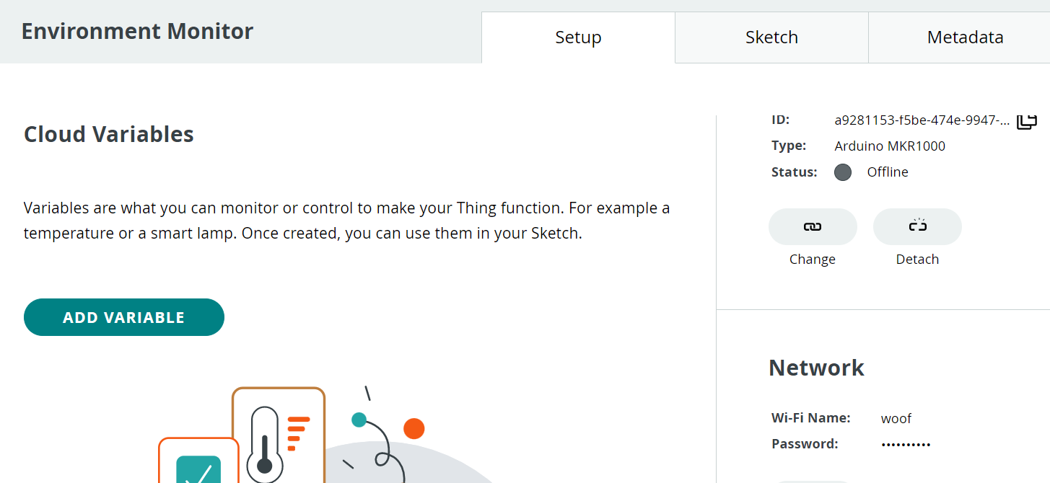
Network Configuration
You need to connect your Arduino to the Wi-Fi network.
The credentials entered are saved in the Secret file, inside the sketch.
Part of the “Thing” configuration.

Slide 9
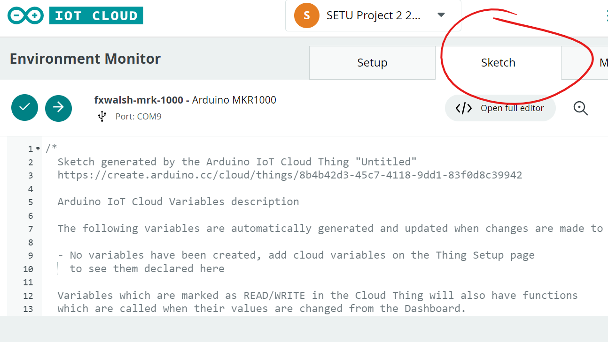
Coding in Arduino Cloud
Clicking on “Sketch” tab in the Thing allows you to code
Works similar to IDE you’ve been using so far.
Initially, automatically generated code is found in the editor

Slide 10
Coding in the Arduino Cloud
The sketches generated automatically in IoT Cloud include four files:
thingProperties.h: This is a file containing the configuration details generated by the Arduino IoT Cloud. it should not be edited.
sketch.ino: This file includes the main Arduino sketch that you edit
Secret: This is a file conains sensitive data likepasswords and API keys that will be protected and hidden from public access. The network configuration details are saved in this file.
ReadMe.adoc: This is a Read Me file as a placeholder for adding a description of the project.

Slide 11
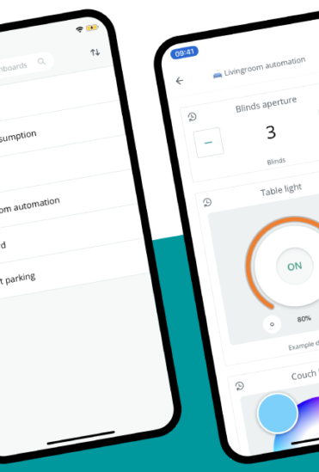
Arduino IoT Remote App
App gives you access to Dashboards.
Gives you with the ability to access, monitor or control your IoT projects from anywhere.
IoS and Android apps available for installation.

